Slide 1
StudentBook
The only social media platform that you need as a student to connect with others for your study and career needs.

Slide 2
Why StudentBook?

Slide 3
Users of StudentBook
Students
Alumni
Faculty
Staff

Slide 4
Usage of StudentBook
Sharing posts
Sharing resources
Official Article portal
Official Notice/Announcement
Online Meeting/Scheduling
Social activities
Official Job Portal

Slide 5

Facebook Vs. StudentBook
Why we need StudentBook when we already have Facebook?
Avoid Time Wastage
For a specific group of people
Official portal for Job circulars
Official portal for necessary resource sharing
Official and restricted platform for aiming to connect like minded group of people

Slide 6

Want big impact?

Slide 7
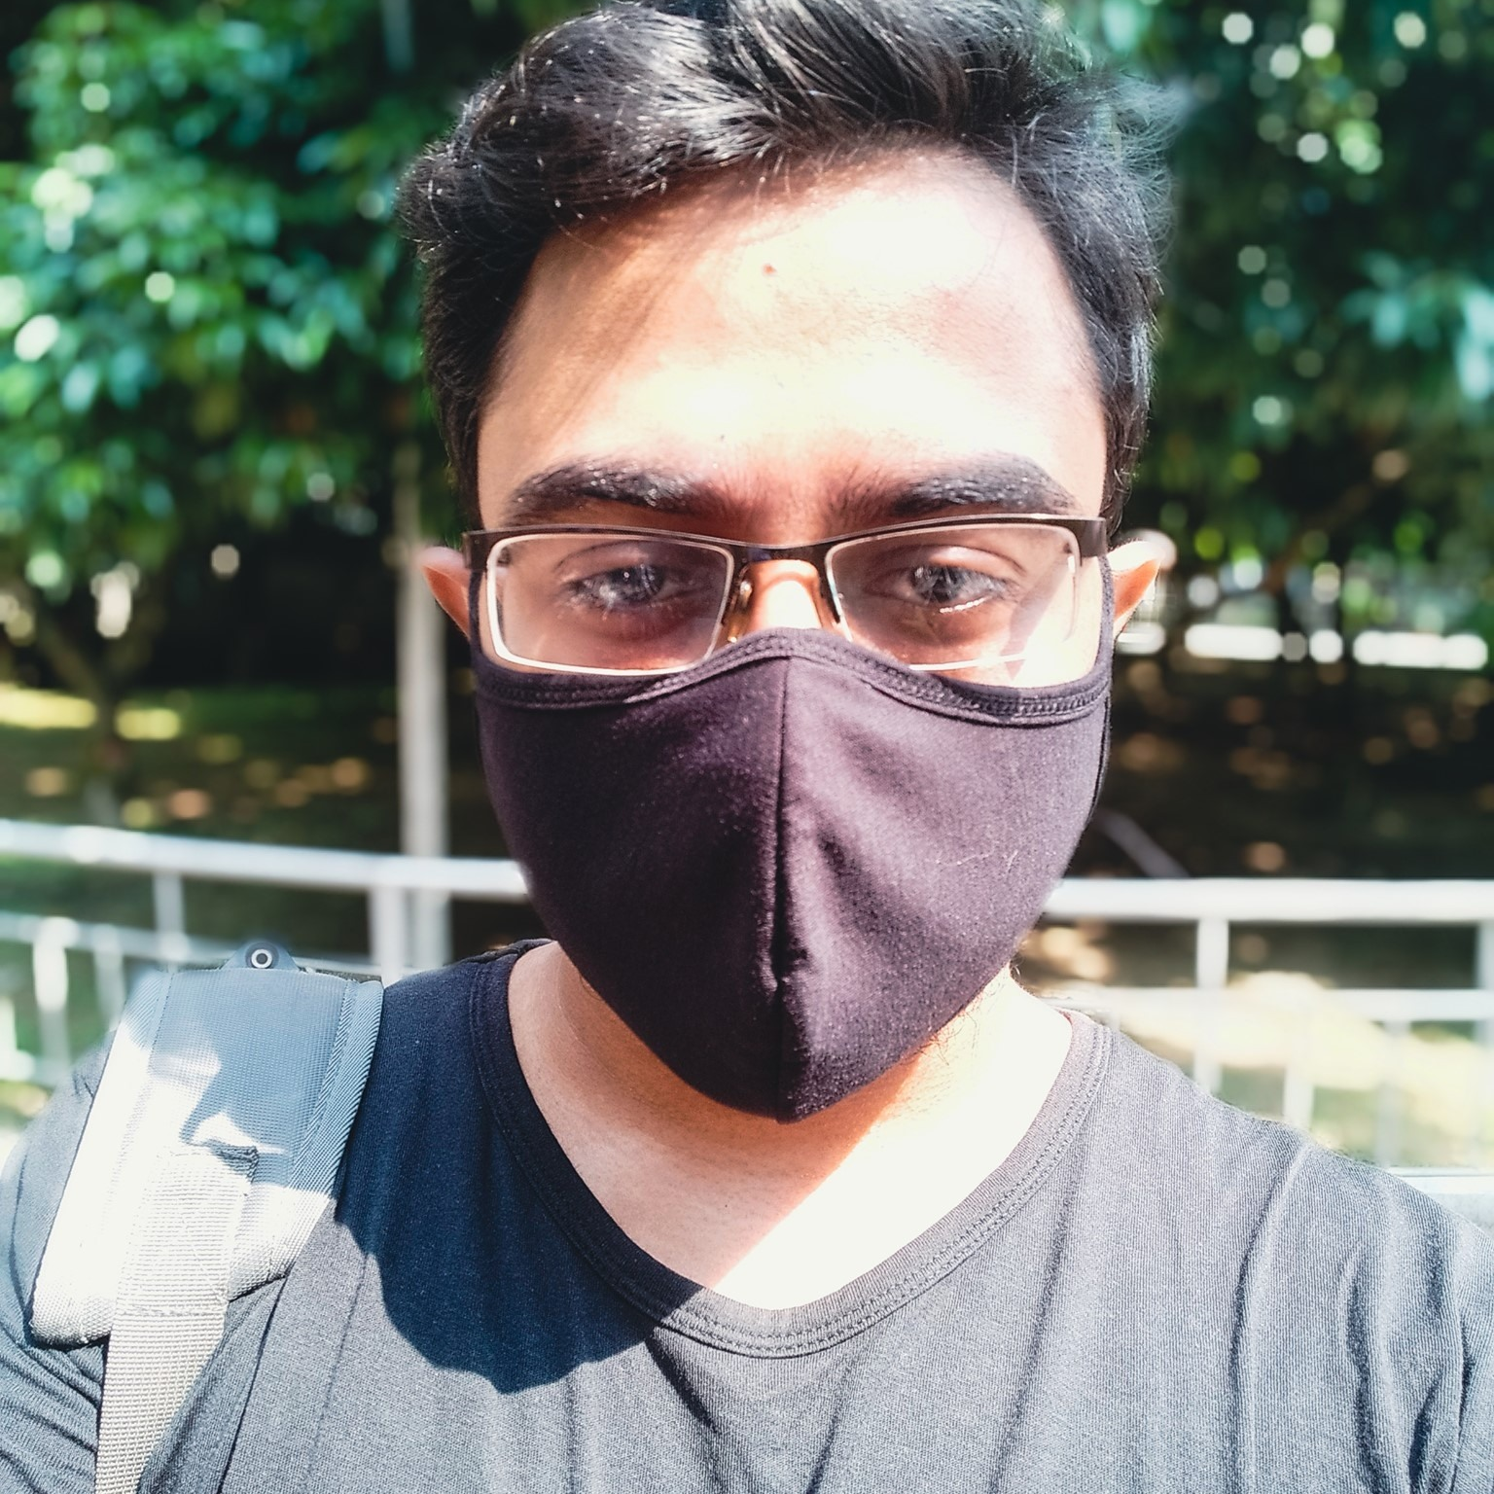
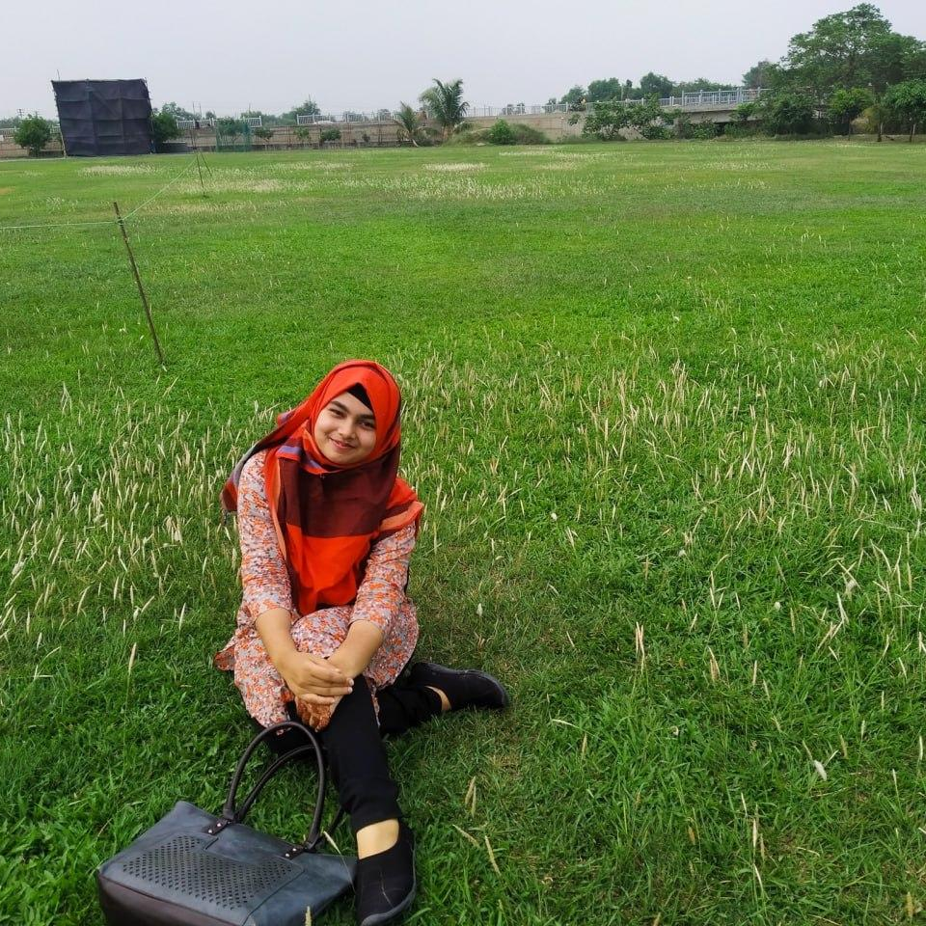


Team Members
Md. Fahim Bin Amin
Team Lead
ID: 011201158
Israt Jahan Khan
RDBMS and Frontend
ID: 011201142
Sadia Afrin Mou
RDBMS
ID: 011211102
Abtahi Arifeen
RDBMS
ID: 011212044

